Slide 1
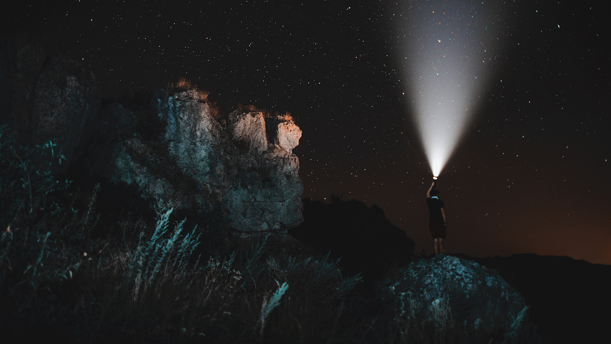
Classification Between Galaxies and Stars
Wooseok Lee

Slide 2

CAN YOU DISTINGUISH BETWEEN THEM WITH ‘A PICTURE’?
A STAR is an astronomical object consisting of a luminous spheroid of plasma held together by its own gravity.
A GALAXY is a gravitationally bound system of stars, stellar remnants, interstellar gas, dust, and dark matter.

Slide 3
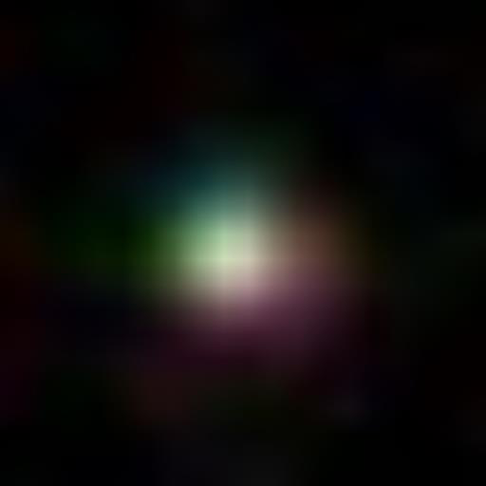
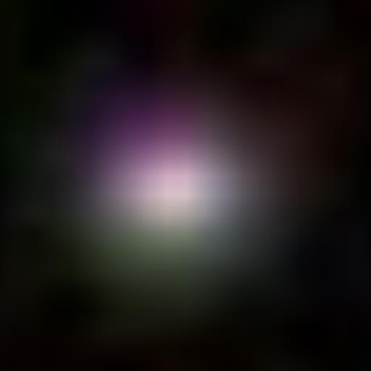
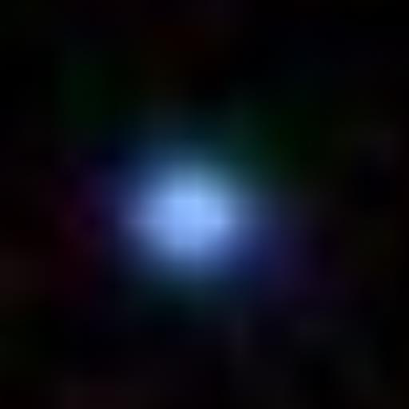
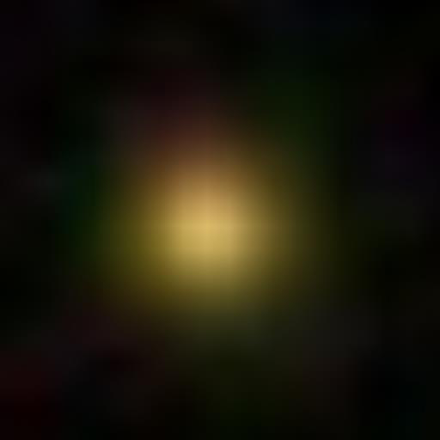
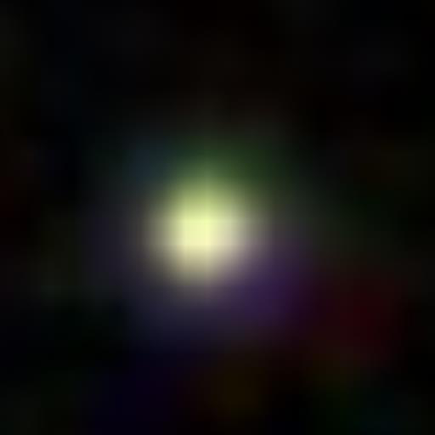
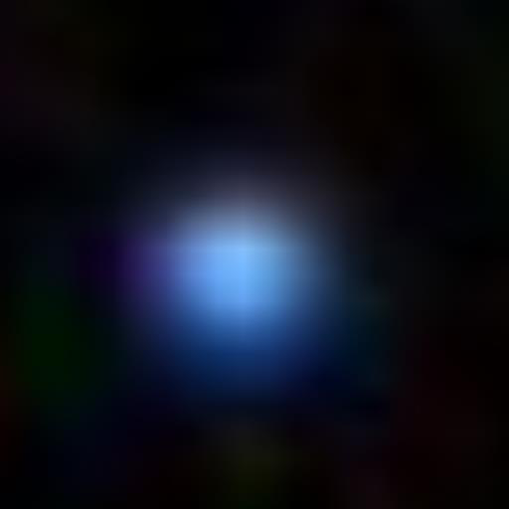
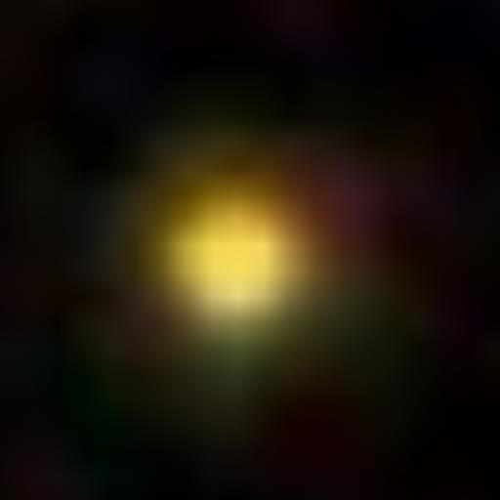
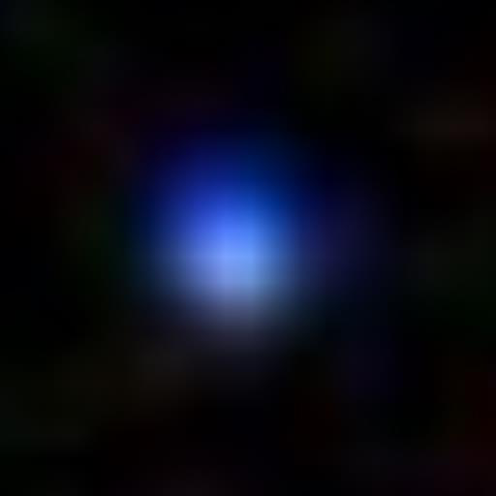
GALAXY
STAR? GALAXY?
?
STAR

Slide 4
A TIMELINE FOR CLASSIFICATION
😀
🙂
ORIGINALLY
Take a picture of the target
Maybe another picture of different time is needed

Slide 5
...
😐
😟
😩
Check if it is already known
Analyze several pictures of different filters
...
Okay, now I got it... But it took so many steps

Slide 6
A TIMELINE FOR CLASSIFICATION
😀
🙂
ORIGINALLY
Take a picture of the target
Maybe another picture of different time is needed
😀
🤩
COOL CLASSIFIER MADE BY ML
Take a picture of the target
Into the classifier...
And done!

Slide 7
...
😐
😟
😩
Check if it is already known
Analyze several pictures of different filters
...
Okay, now I got it... But it took so many steps
...
😊
🛰 🚀
🏆⁉️
HAPPY!
RESEARCH GOES EXTREMELY WELL!!
...
NOBEL...PRIZE!?

Slide 8
PREPROCESSING DATA
Dataset from https://www.kaggle.com/siddharthchaini/stars-and-galaxies
Original PDF files -> 28x28 PDF files -> CSV files
R, G, B values for each pixel
Five pictures of stars and galaxies were stacked alternately
Labeled stars as 1, galaxies as 0

Slide 9
CLASSIFIERS WITH TWO METHODS
MULTI-LAYER PERCEPTRON
RANDOM FOREST
- Used two-layer perceptron
- Used 1, 5, 10, 50, 100, 500 trees

Slide 10
TWO-LAYER PERCEPTRON - WITH 100 AND 200 HIDDEN LALYER’S DIMENSION - FOR 10 AND 20 TRAINING EPCOH
INPUT LAYER
HIDDEN LAYER
OUTPUT LAYER
training epoch: 10, 20
10 dim
100, 200 dim
2352 dim
=28(pixels)*28(pixels)*3(R, G, B)

Slide 11


RANDOM FOREST - WITH 1, 5, 10, 50, 100, 500 TREES - ACCURACY WITH BOTH OF THE TRAINING DATASET AND TEST DATASET
A tree (= Decision Tree)
more
tress
Random Forest

Slide 12
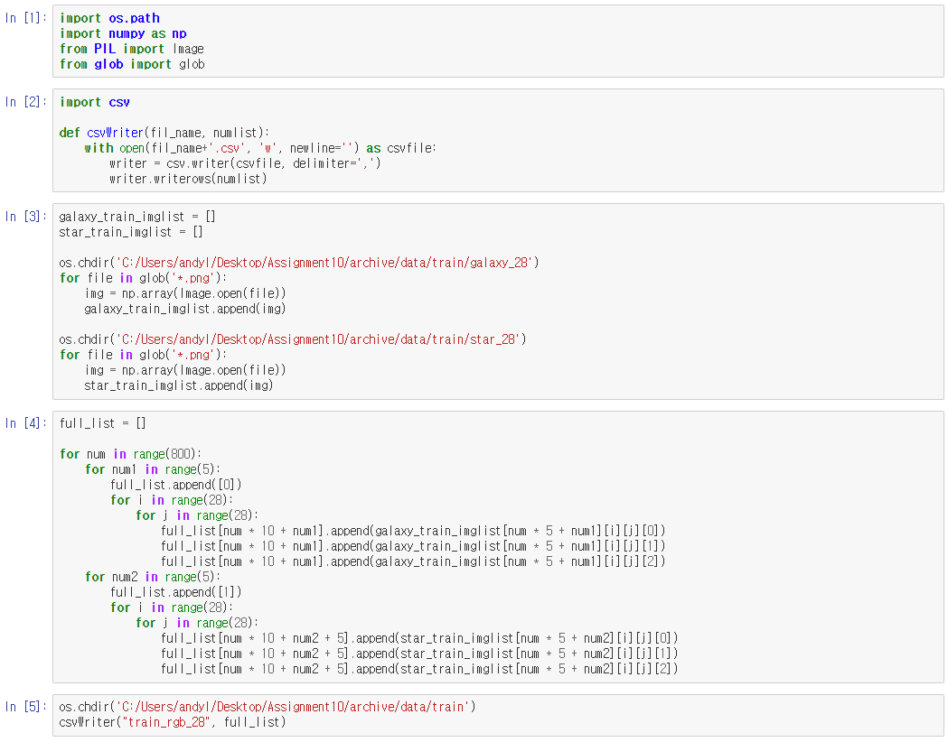
TWO-LAYER PERCEPTRON CODE +PREROCESSING
For code details, please check my github repo.
https://github.com/andylws/Classification-between-Galaxies-and-Stars-with-MLP-and-RF

Slide 13
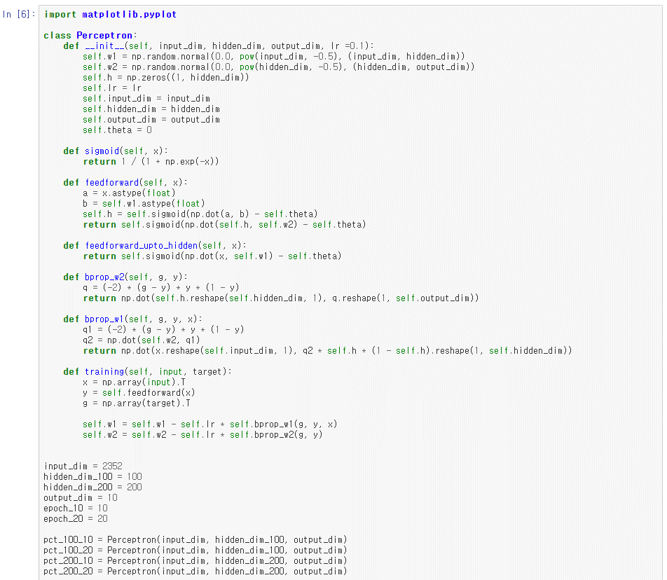
TWO-LAYER PERCEPTRON CODE +PREROCESSING
For code details, please check my github repo.
https://github.com/andylws/Classification-between-Galaxies-and-Stars-with-MLP-and-RF

Slide 14
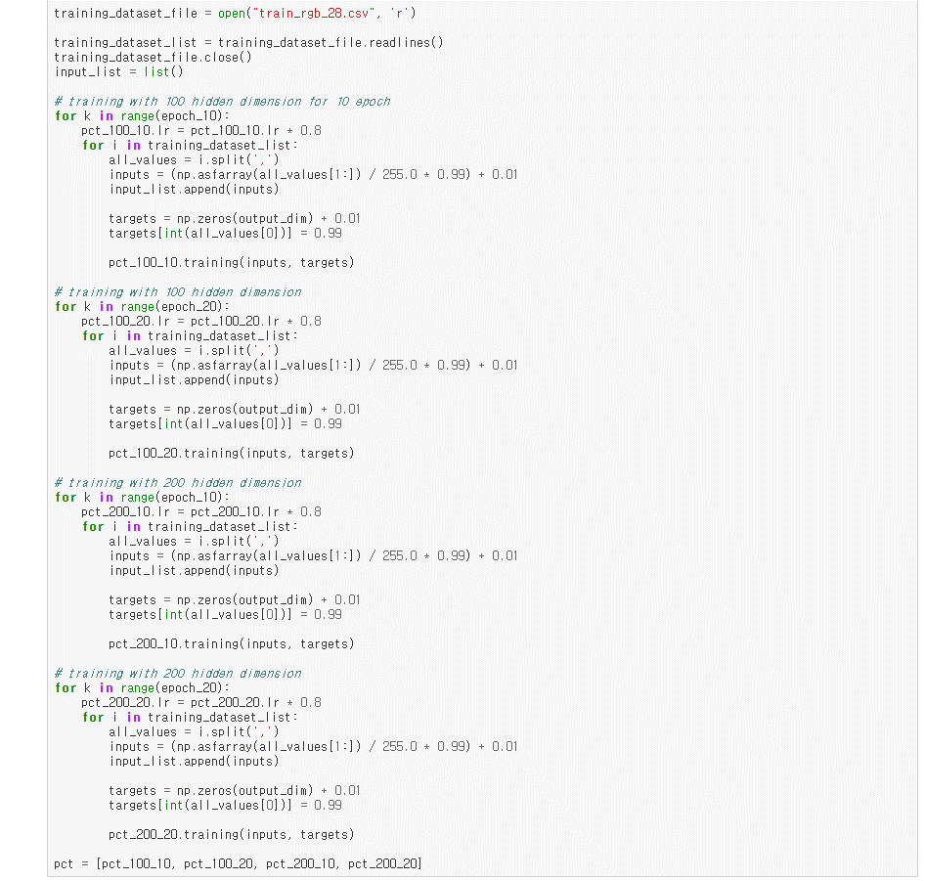
TWO-LAYER PERCEPTRON CODE +PREROCESSING
For code details, please check my github repo.
https://github.com/andylws/Classification-between-Galaxies-and-Stars-with-MLP-and-RF

Slide 15
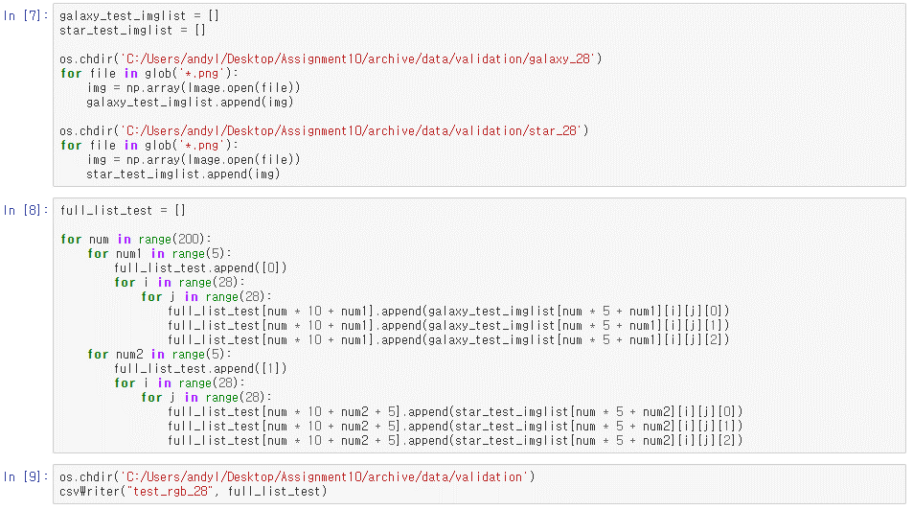
TWO-LAYER PERCEPTRON CODE +PREROCESSING
For code details, please check my github repo.
https://github.com/andylws/Classification-between-Galaxies-and-Stars-with-MLP-and-RF

Slide 16
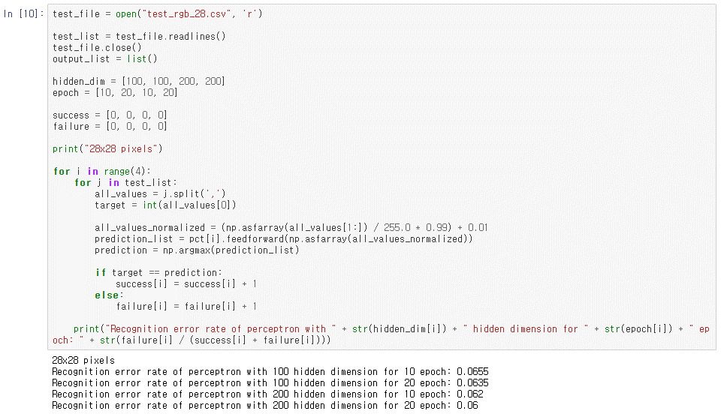
TWO-LAYER PERCEPTRON CODE +PREROCESSING
For code details, please check my github repo.
https://github.com/andylws/Classification-between-Galaxies-and-Stars-with-MLP-and-RF

Slide 17
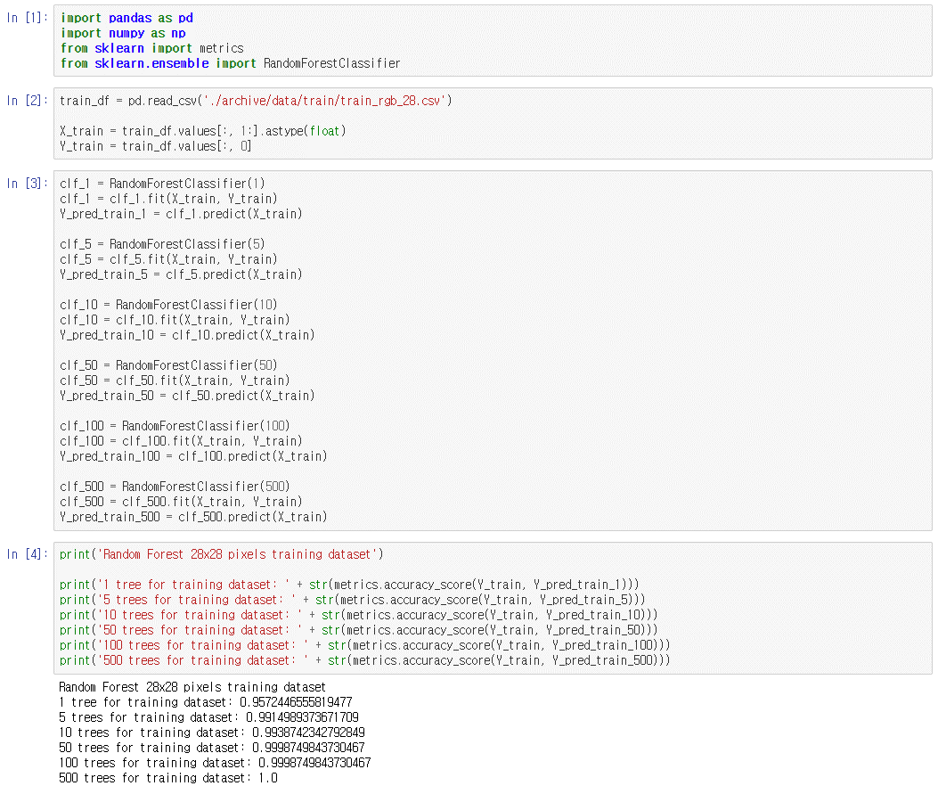
RANDOM FOREST CODE
For code details, please check my github repo.
https://github.com/andylws/Classification-between-Galaxies-and-Stars-with-MLP-and-RF

Slide 18
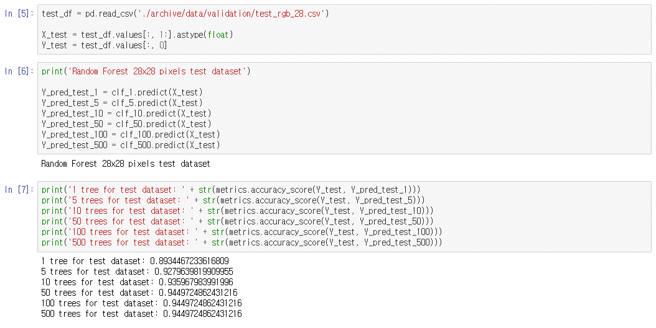
RANDOM FOREST CODE
For code details, please check my github repo.
https://github.com/andylws/Classification-between-Galaxies-and-Stars-with-MLP-and-RF

Slide 19
ACCURACY - TWO-LAYER PERCEPTRON
 | 100 hid_dim | 200 hid_dim
10 epoch | 93.45% | 93.8%
20 epoch | 93.65% | 94%
The larger dimension size of hidden layer, the higher accuracy.
The larger training epoch, the higher accuracy.
But not a big difference.

Slide 20
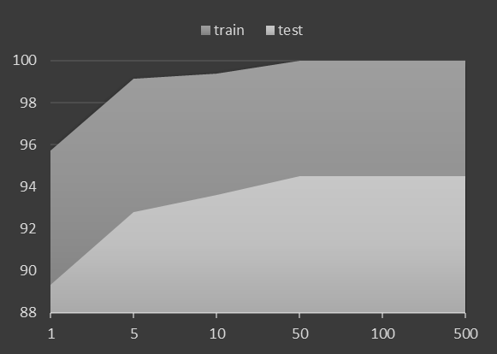
ACCURACY - RANDOM FOREST
 | Training dataset | Test dataset
1 tree | 95.73% | 89.34%
5 trees | 99.15% | 92.80%
10 trees | 99.39% | 93.60%
50 trees | 99.99% | 94.50%
100 trees | 99.99% | 94.50%
500 trees | 100% | 94.50%
As the number of trees increased, the accuracy of classifying training dataset converged to 100%.
As the number of trees increased, the accuracy of classifying test dataset converged to 94.50%.
However, there was no difference on accuracy after the number of trees got bigger than 50.

Slide 21
ACCURACY - RANDOM FOREST + additionally, 56x56 pixel images
 | Training dataset | Test dataset
1 tree | 95.46% | 88.74%
5 trees | 98.91% | 92.80%
10 trees | 99.55% | 93.55%
50 trees | 99.99% | 94.40%
100 trees | 100% | 94.45%
500 trees | 100% | 94.45%
Similar accuracy with the accuracy with 28x28 pixels images.

Slide 22
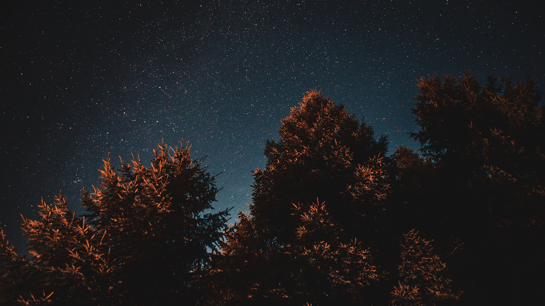
Two-Layer Perceptron and Random Forest showed similar highest accuracy about 94% ~ 94.50%.
It’s hard to say which method is better than the other.
With this accuracy, some light project could be done. But for serious researches, this is too low accuracy.
For a dramatic leap of accuracy, some other ML methods should be considered.
As a follow-up study, studies using various neural networks consisting of different structures or other deep learning methods need to be attempted.
+ There was little effect of pixel size. Maybe 28x28 pixel size was enough for classifying.

Slide 23
THANKS!
Do you have any questions?
andylws@snu.ac.kr
https://github.com/andylws/Classification-between-Galaxies-and-Stars-with-MLP-and-RF

